Slide 1


Slide 2

19%
sparen!
10,^{49 €}
12,97 €**

Slide 3

19%
sparen!
13,^{29 €}
16,45 €**
1.329,00 € pro 1.000 ml

Slide 4

13%
sparen!
15,^{59 €}
17,99 €**

Slide 5
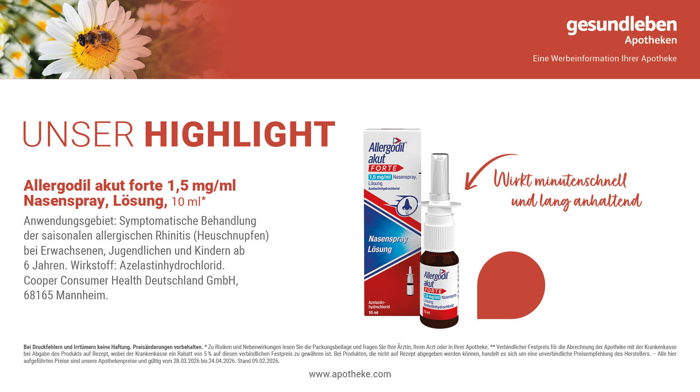
13%
12,^{99 €}
sparen!
14,95 €**
1.299,00 € pro 1.000 ml

Slide 6
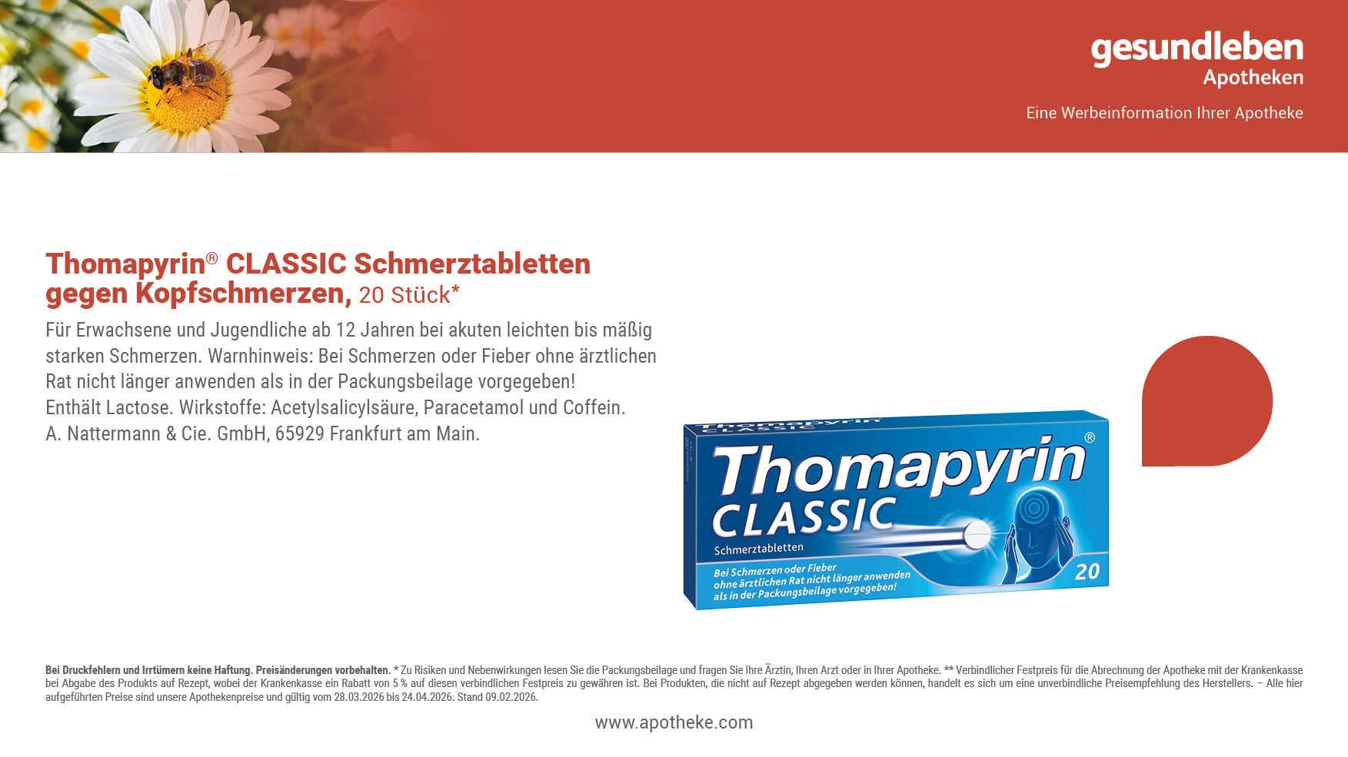
15%
sparen!
7,^{49 €}
8,82 €**

Slide 8
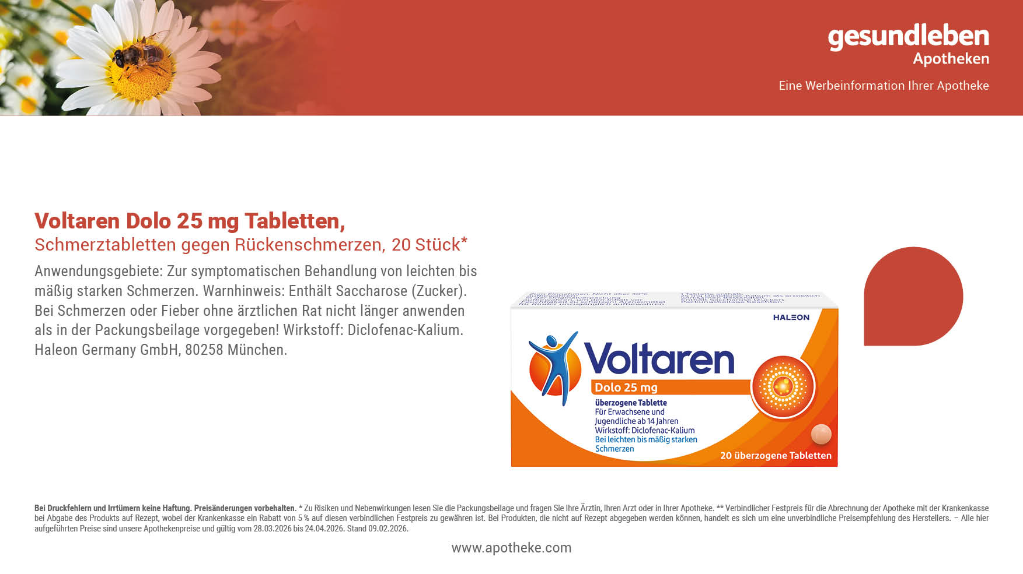
15%
sparen!
10,^{69 €}
12,61 €**

Slide 9
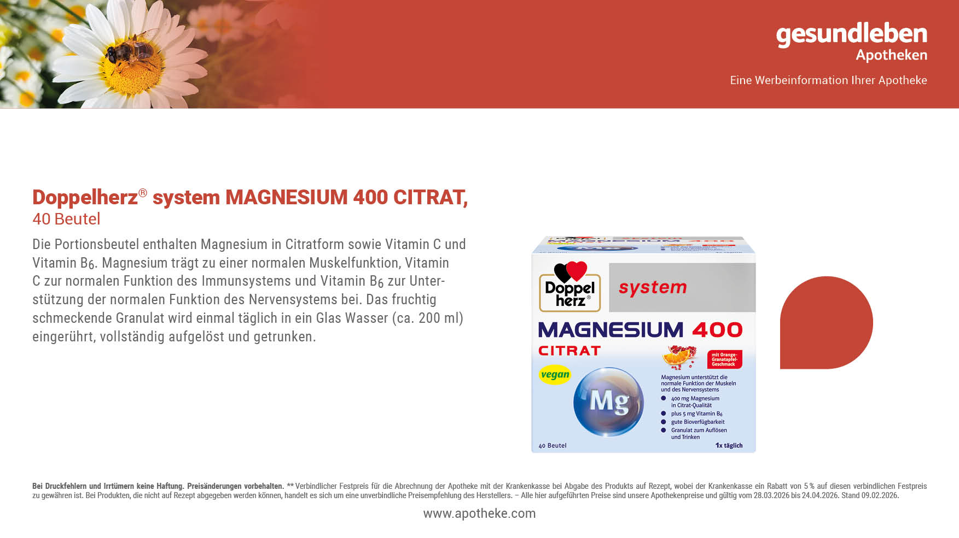
15%
sparen!
13,^{49 €}
15,95 €**

Slide 10
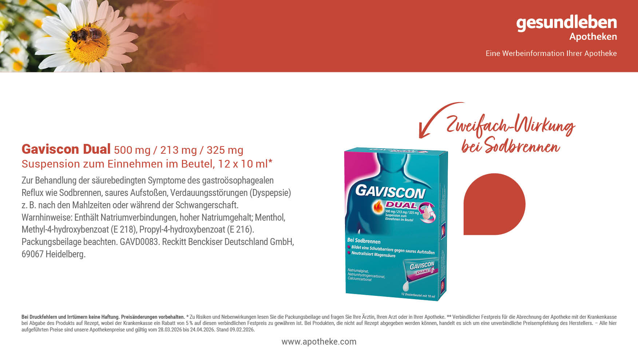
15%
sparen!
11,^{89 €}
13,99 €**
99,08 € pro 1.000 ml

Slide 11
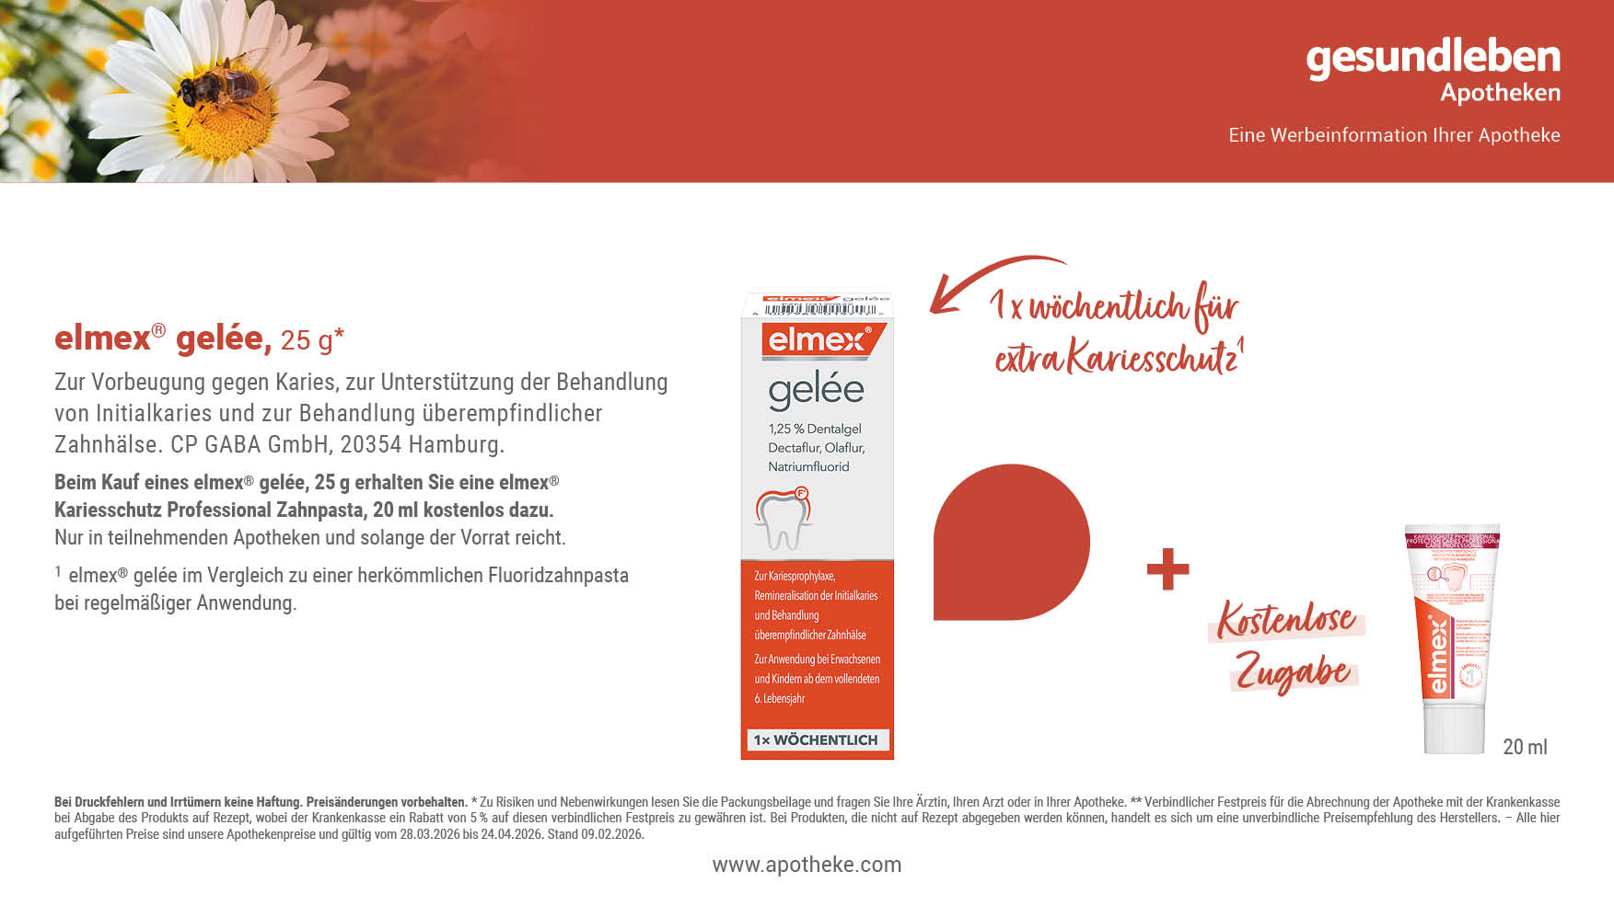
13%
sparen!
16,^{49 €}
18,98 €**
659,60 € pro 1.000 g

Slide 12
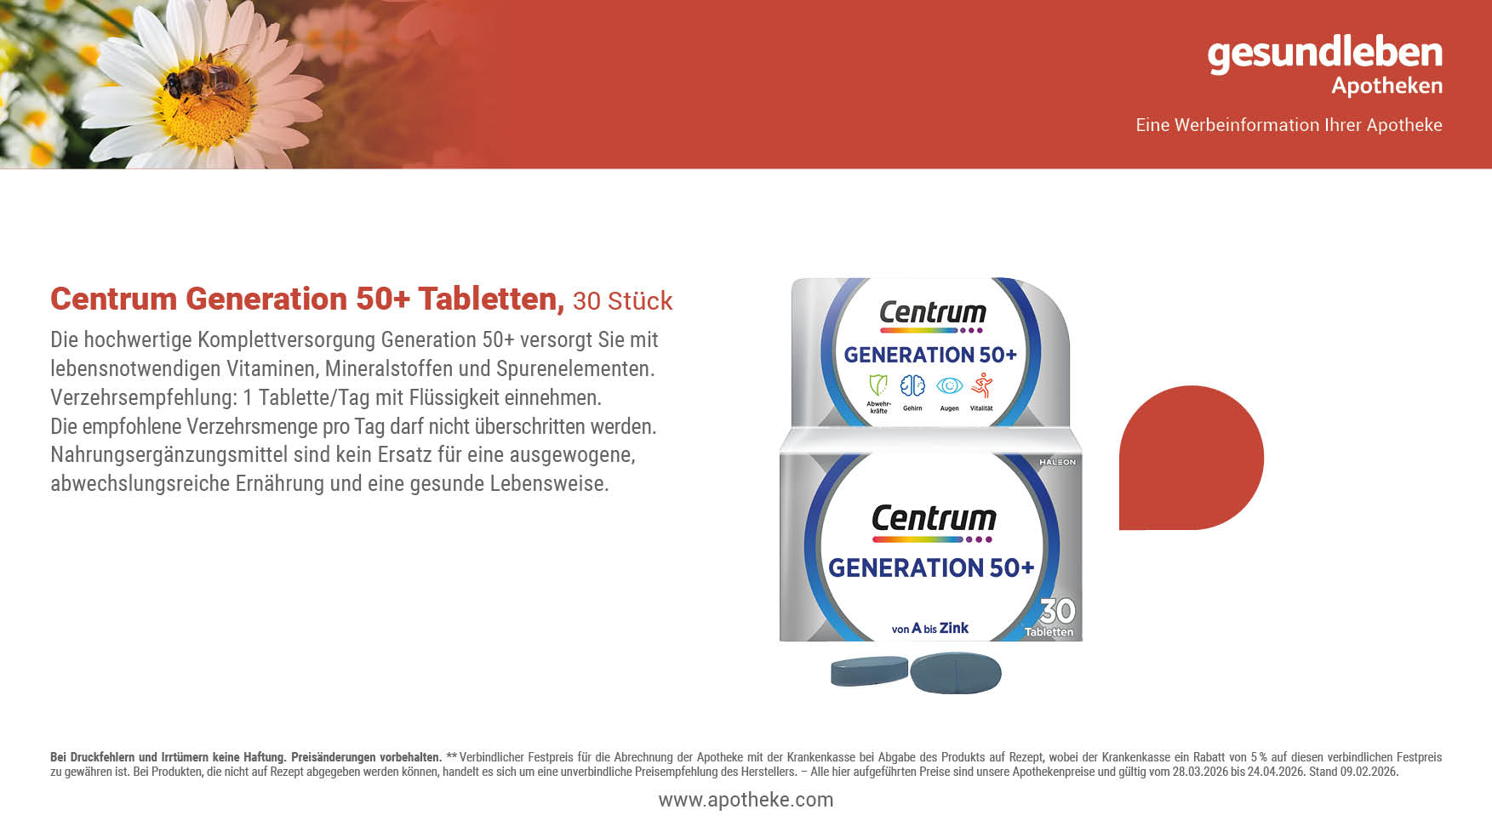
13%
sparen!
14,^{49 €}
16,69 €**

Slide 13

13%
sparen!
10,^{39 €}
11,95 €**

Slide 15
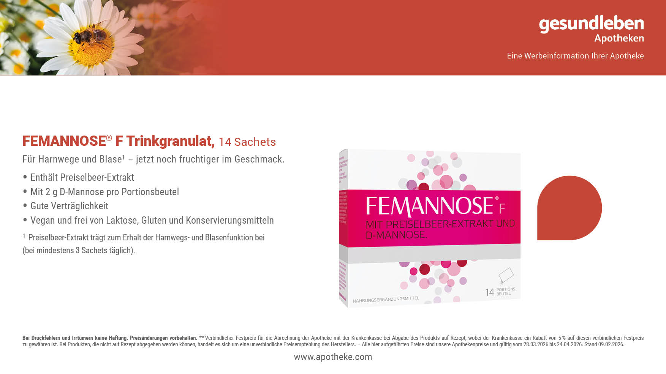
13%
sparen!
21,^{29 €}
24,49 €**

Slide 16

^{Unser}
^{Preis}
13,^{69 €}

Slide 17
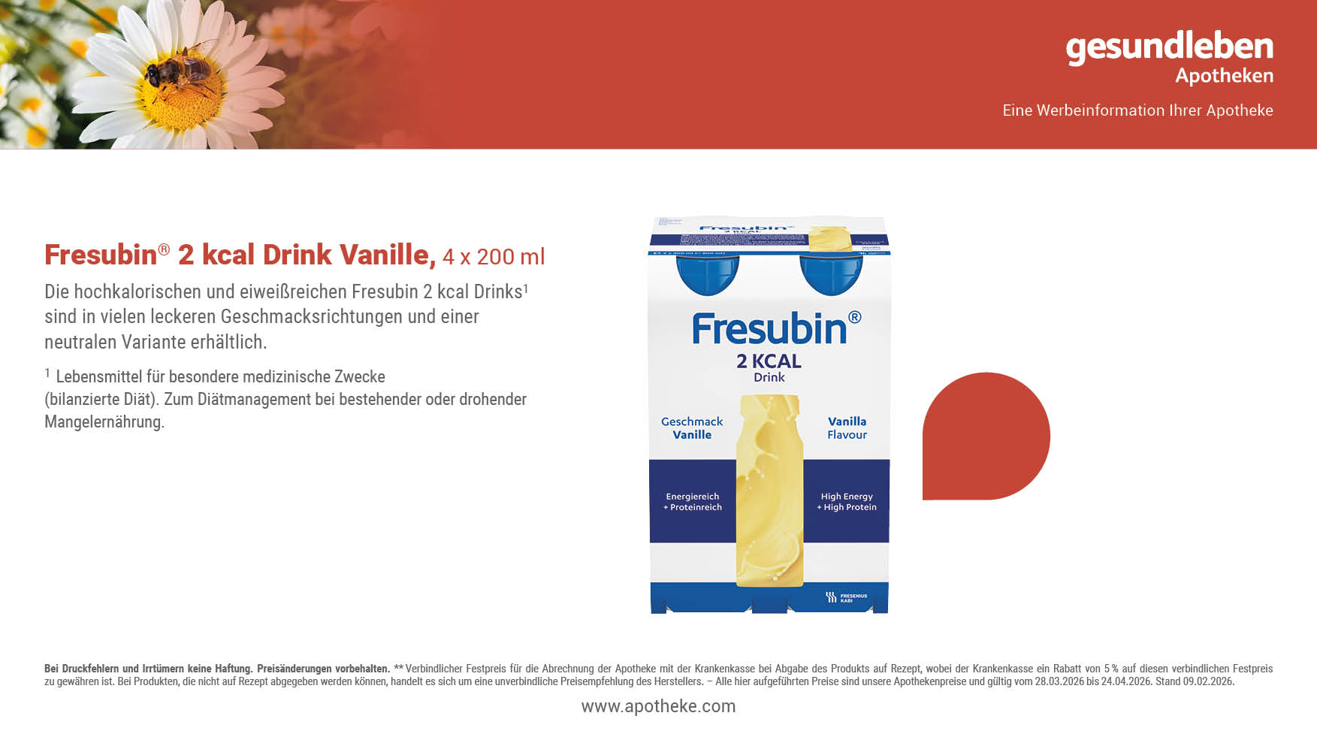
13%
sparen!
23,^{19 €}
26,67 €**
28,99 € pro 1.000 ml

Slide 18

12%
sparen!
12,^{19 €}
13,95 €**

Slide 19
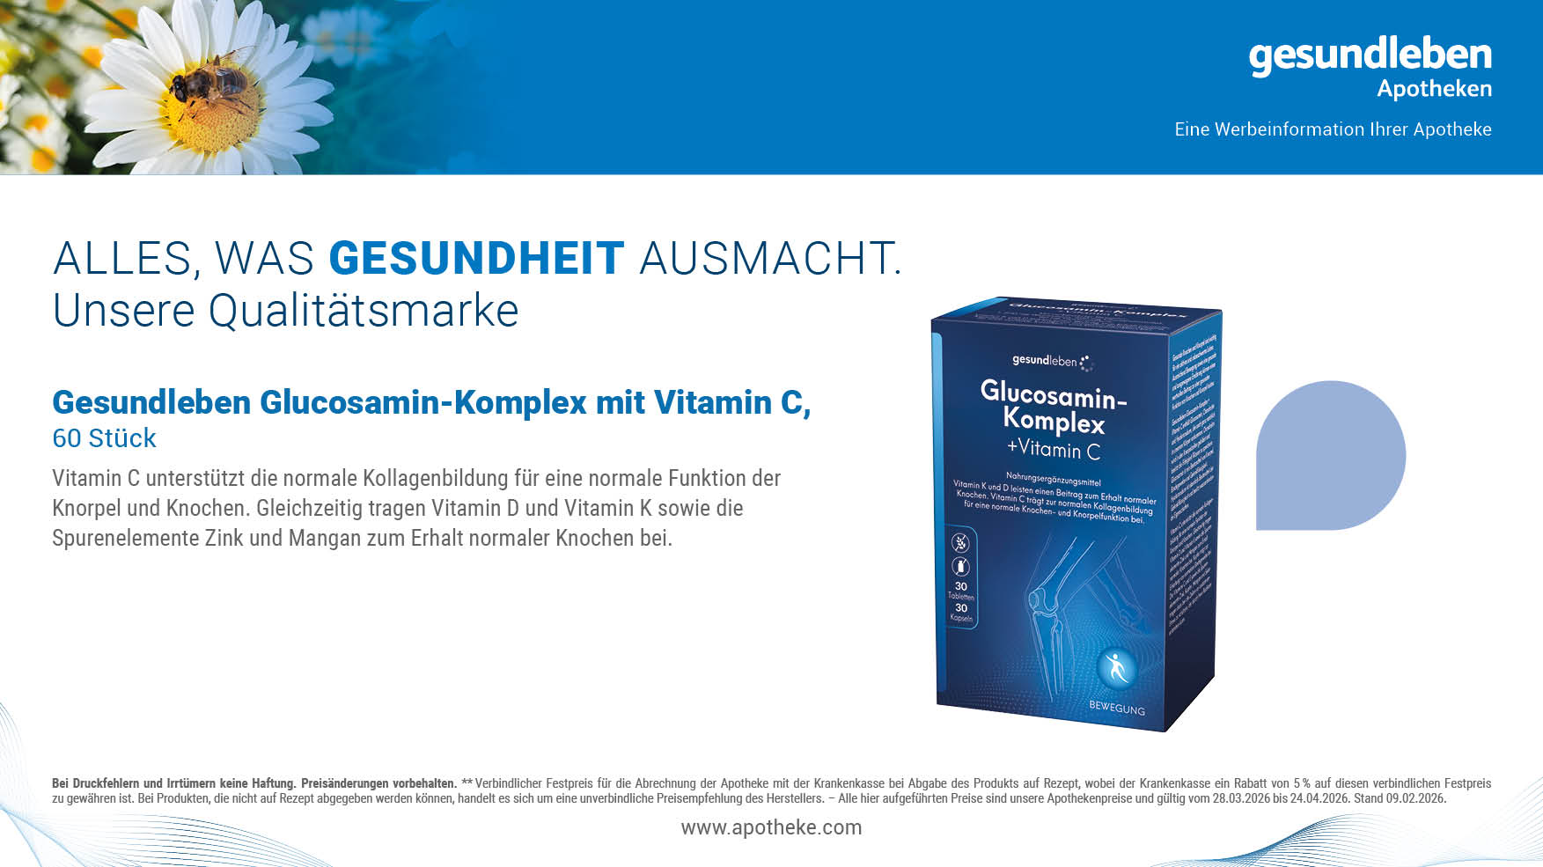
13%
sparen!
18,^{99 €}
21,95 €**

Slide 20

13%
sparen!
8,^{59 €}
9,95 €**

Slide 21
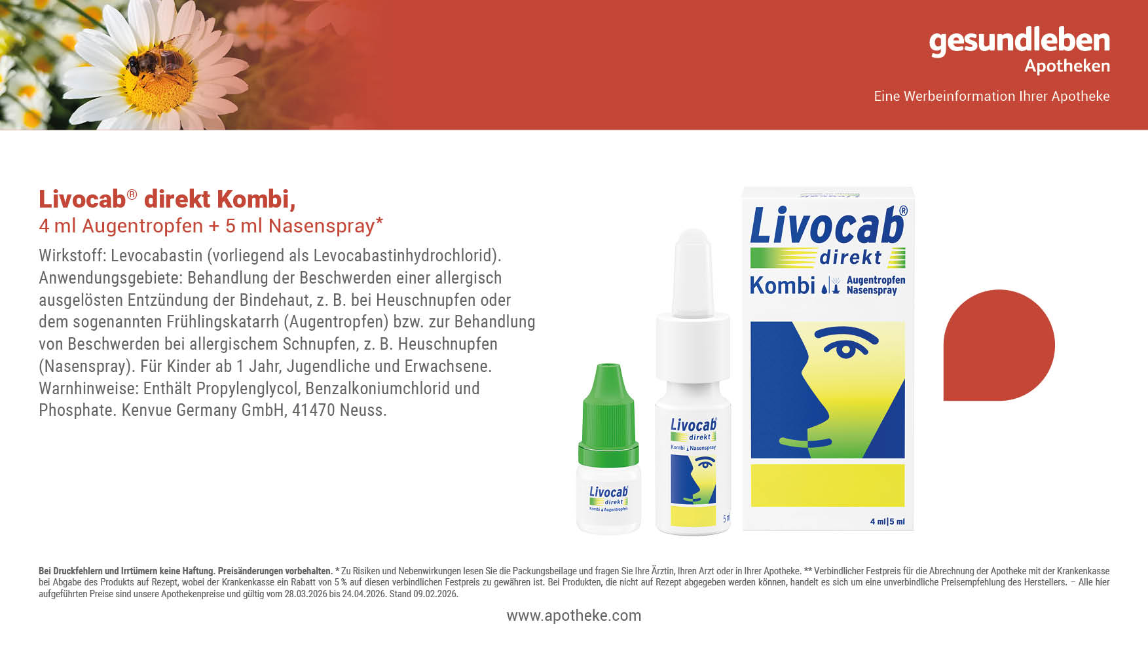
13%
sparen!
17,^{69 €}
20,36 €**

