Slide 1


Slide 2

30%
sparen!
8,^{99 €}
12,97 €**

Slide 3

30%
sparen!
11,^{49 €}
16,45 €**
1.149,00 € pro 1.000 ml

Slide 4

23%
sparen!
13,^{79 €}
17,99 €**

Slide 5
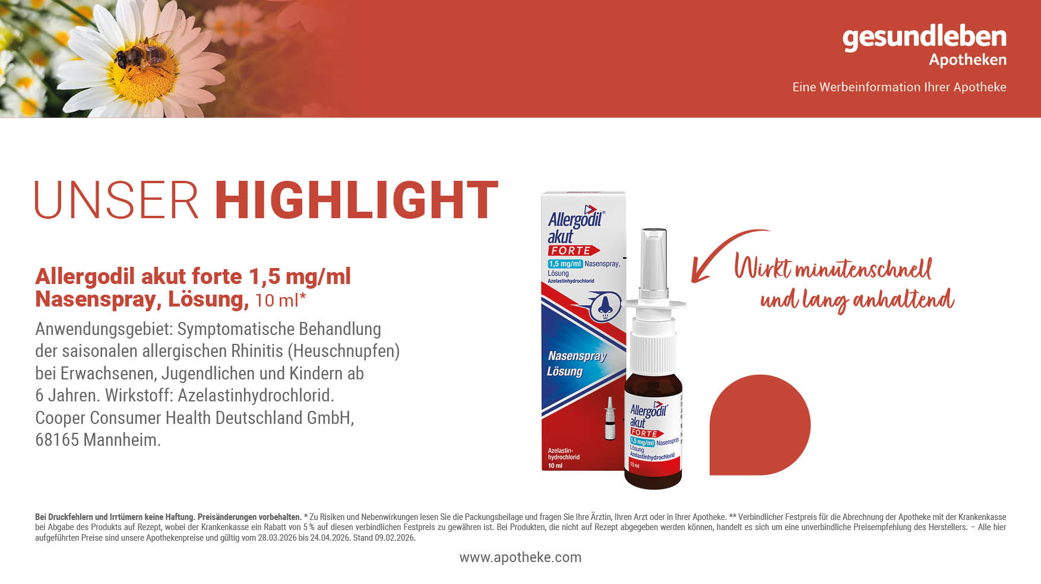
23%
11,^{49 €}
sparen!
14,95 €**
1.149,00 € pro 1.000 ml

Slide 6
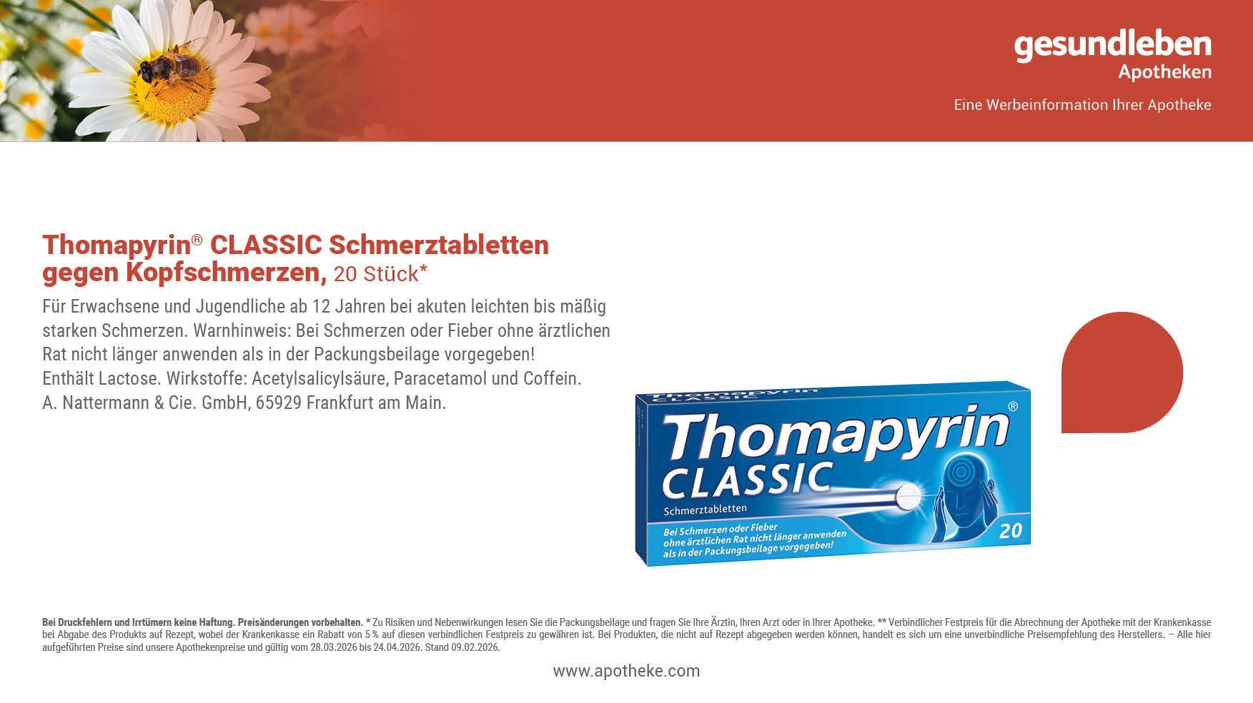
25%
sparen!
6,^{59 €}
8,82 €**

Slide 8
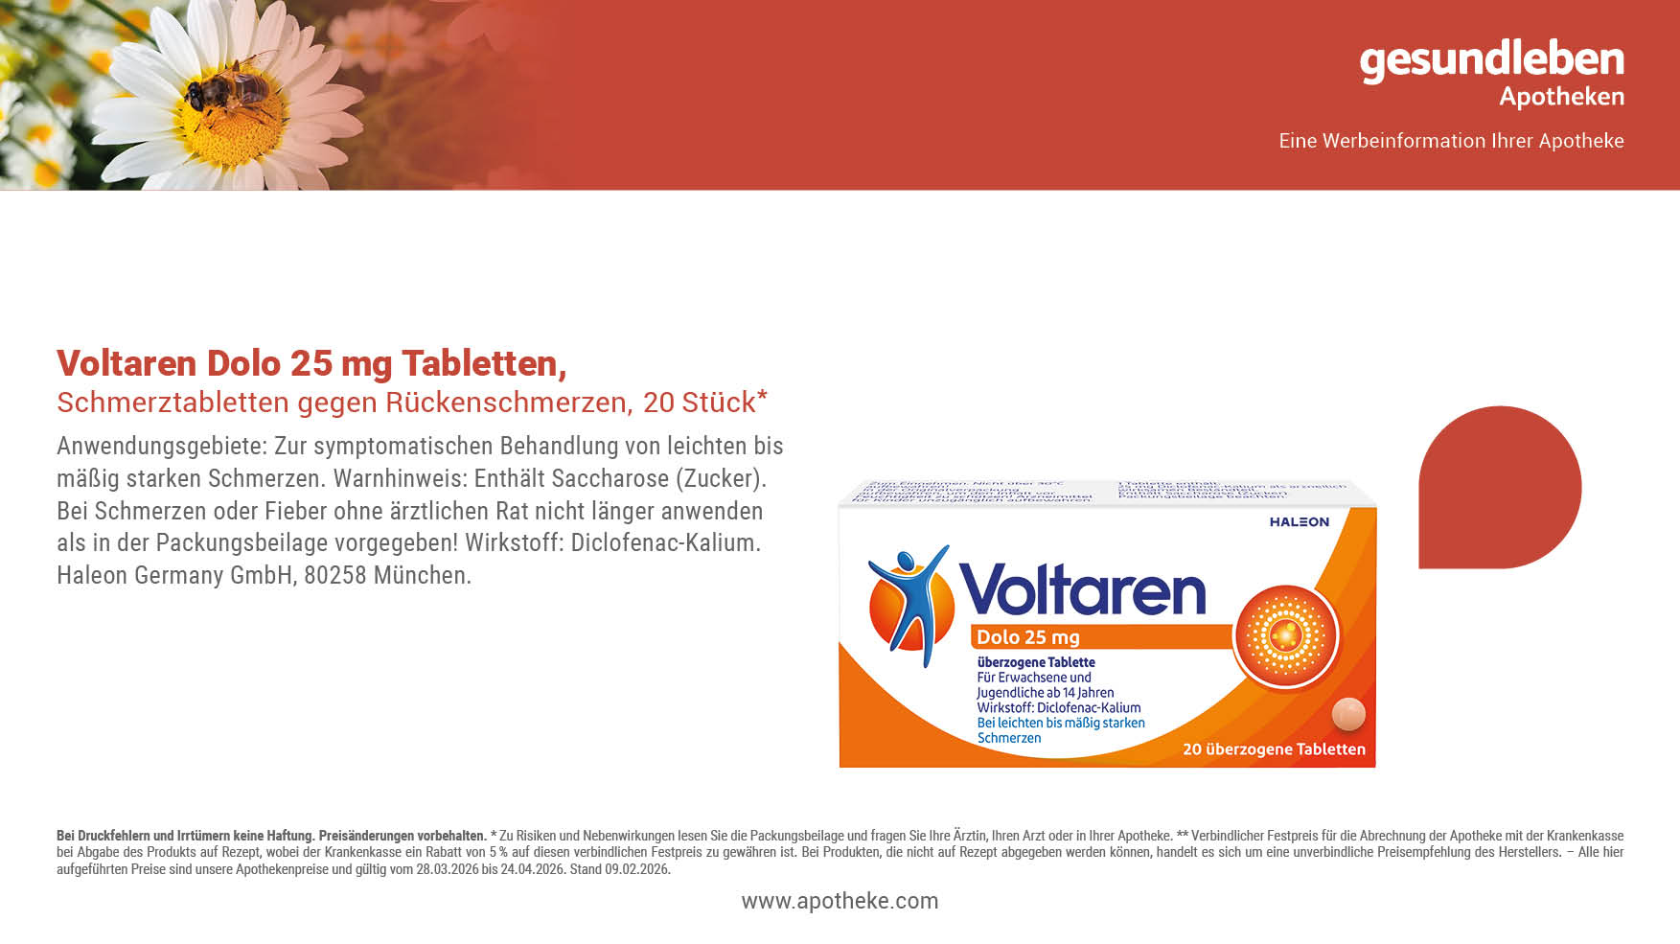
25%
sparen!
9,^{39 €}
12,61 €**

Slide 9
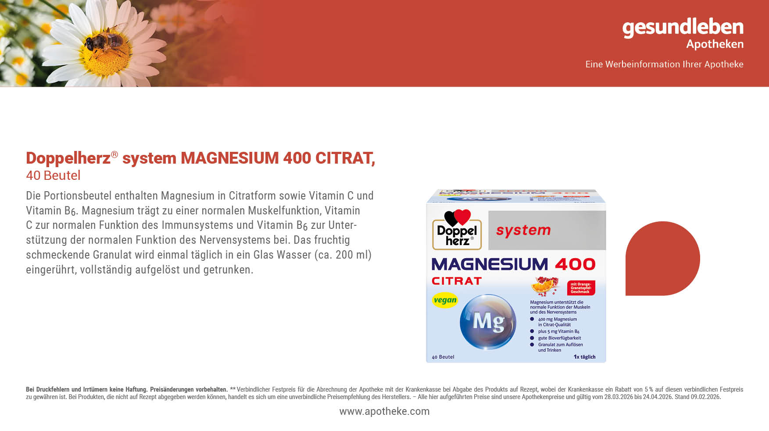
25%
sparen!
11,^{89 €}
15,95 €**

Slide 10
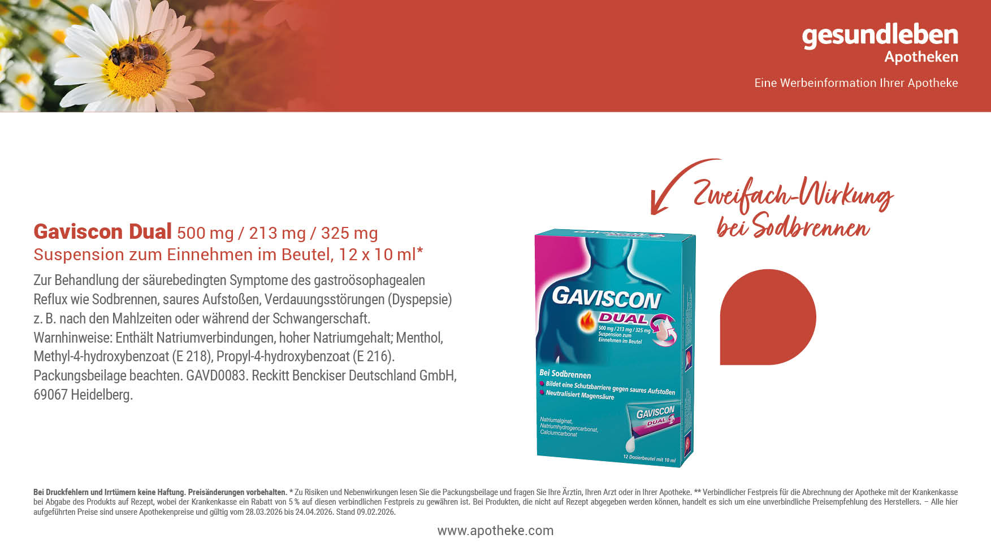
25%
sparen!
10,^{49 €}
13,99 €**
87,42 € pro 1.000 ml

Slide 11
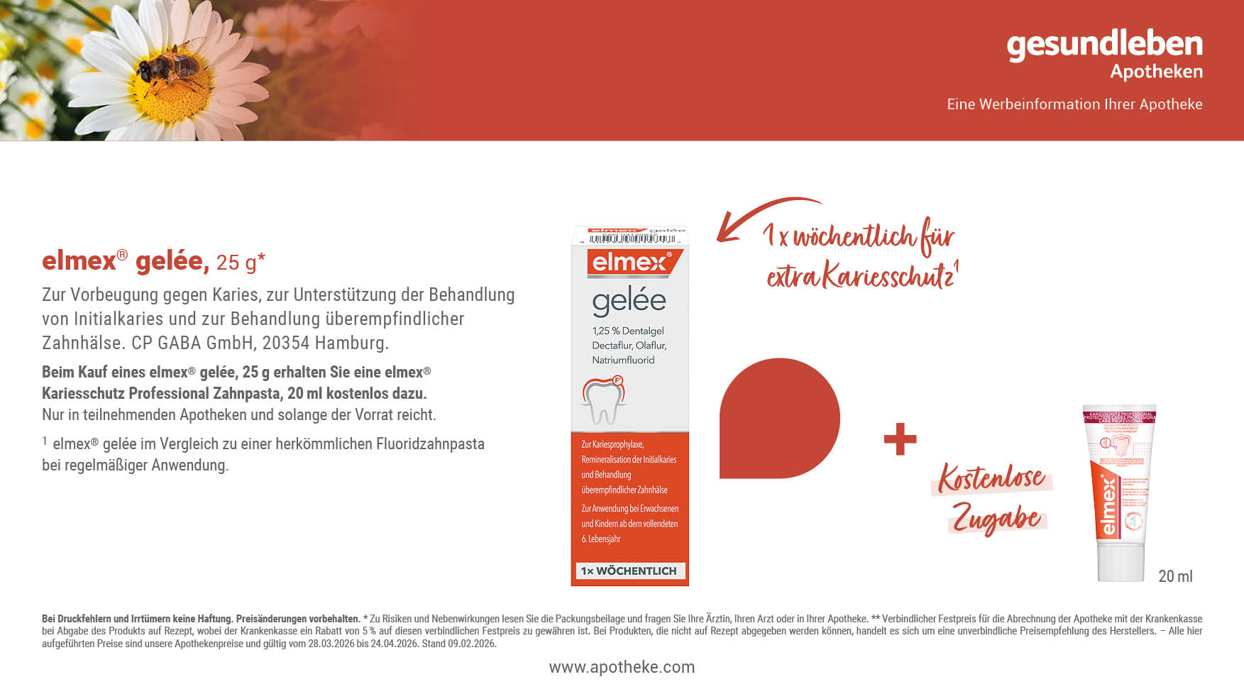
23%
sparen!
14,^{59 €}
18,98 €**
583,60 € pro 1.000 g

Slide 12
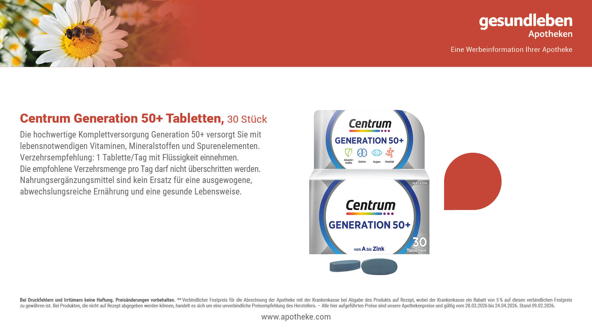
23%
sparen!
12,^{79 €}
16,69 €**

Slide 13

23%
sparen!
9,^{19 €}
11,95 €**

Slide 15

23%
sparen!
18,^{79 €}
24,49 €**

Slide 16

^{Unser}
^{Preis}
11,^{99 €}

Slide 17
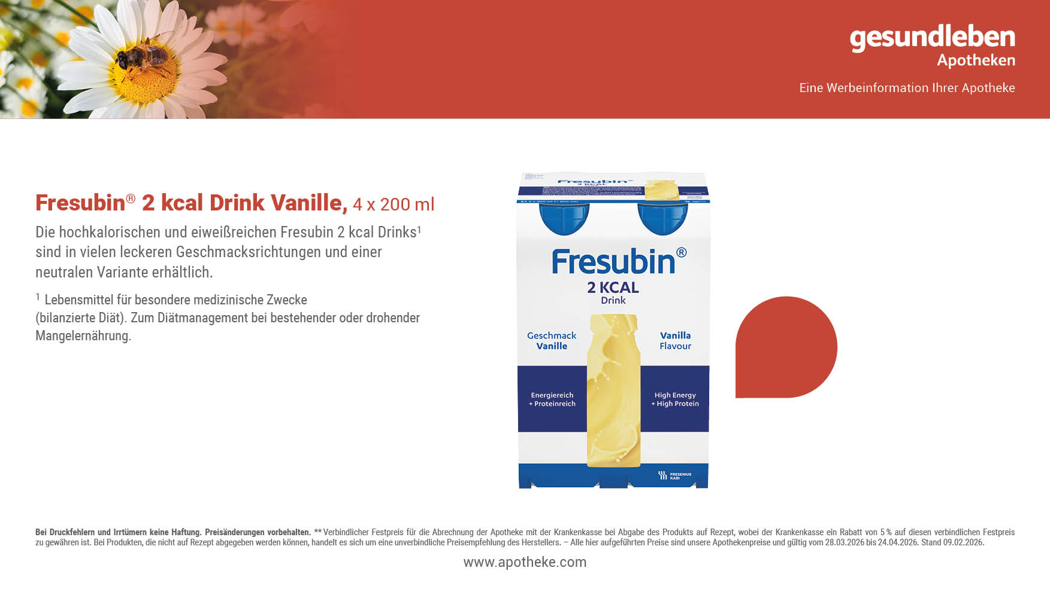
23%
sparen!
20,^{49 €}
26,67 €**
25,61 € pro 1.000 ml

Slide 18

23%
sparen!
10,^{69 €}
13,95 €**

Slide 19
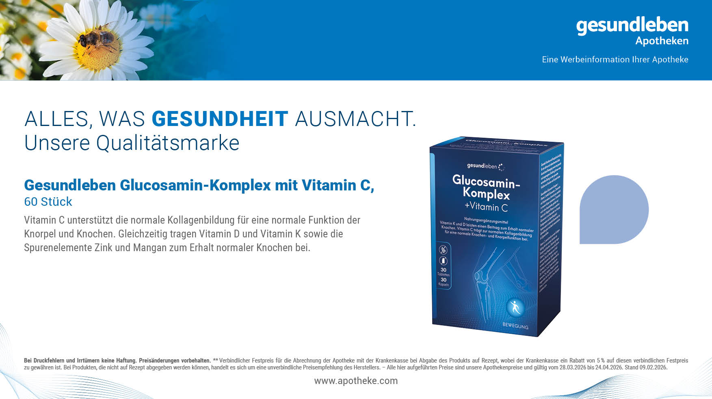
23%
sparen!
16,^{79 €}
21,95 €**

Slide 20

23%
sparen!
7,^{59 €}
9,95 €**

Slide 21
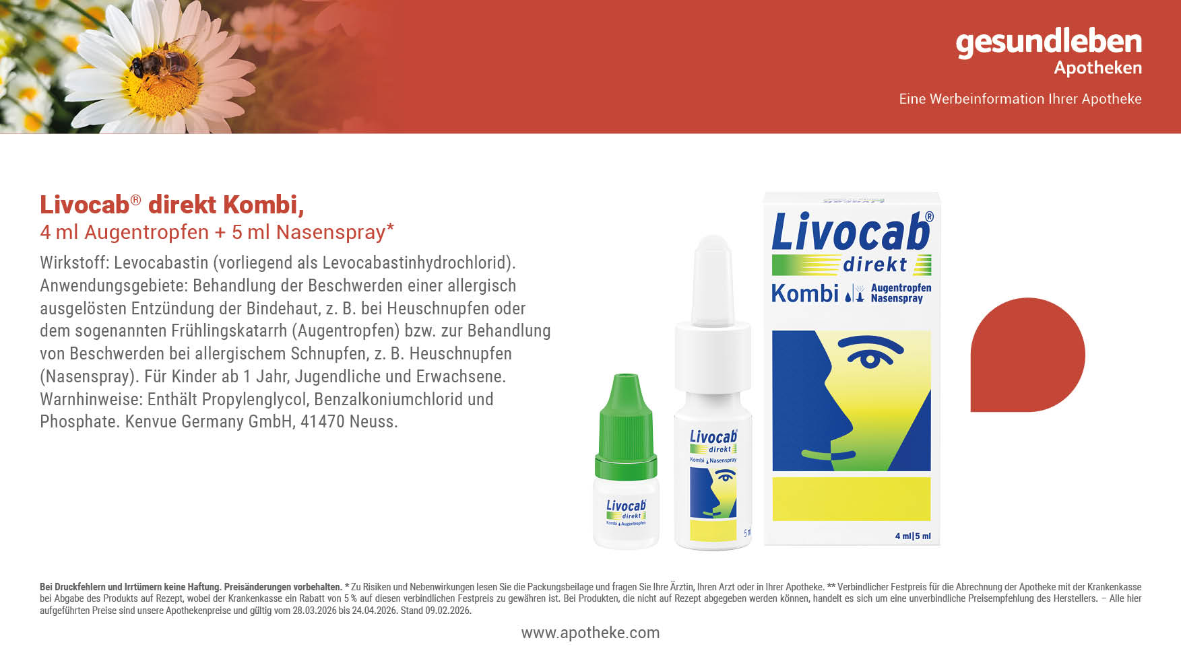
23%
sparen!
15,^{59 €}
20,36 €**

